Slide 1
Internet Control
Message Protocol
(ICMP)

Slide 2
MESSAGE
FORMAT

Slide 3
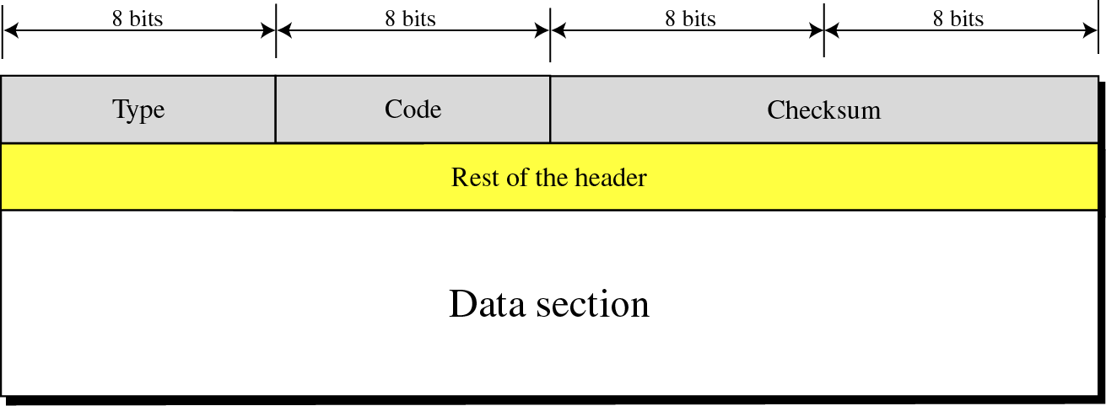
Figure 9-4
GENERAL FORMAT OF ICMP MESSAGES

Slide 4
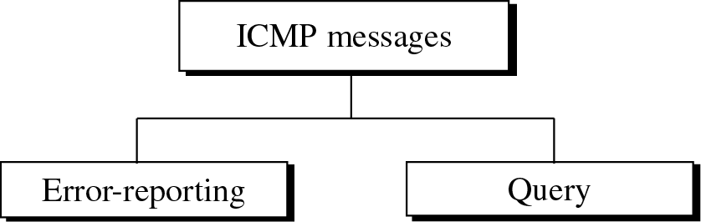
Figure 9-3
ICMP MESSAGES

Slide 5
Category | Type | Message
Error Reporting Messages | 3 | Destination unreachable
 | 4 | Source Quench
 | 11 | Time Exceeded
 | 12 | Parameter Problem
 | 5 | Redirection
Query Messages | 8/0 | Echo Request or reply
 | 13/14 | Time stamp request or reply
 | 17/18 | Address mask request / reply
 | 10/9 | Router Solicitation or advertisement

Slide 6
ERROR
REPORTING

Slide 7
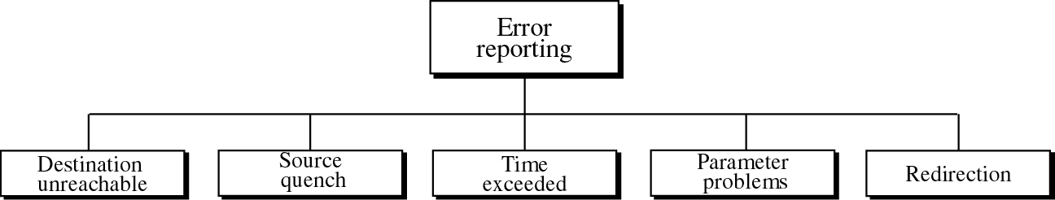
Figure 9-5
ERROR-REPORTING MESSAGES
The error-reporting messages report problems that a router or a host (destination) may encounter when it processes an IP packet.
ICMP always reports error messages to the original source.

Slide 8
Important points about ICMP error messages:
1. No ICMP error message for a datagram carrying an ICMP error message.
2. No ICMP error message for a fragmented datagram that is not the first fragment.
3. No ICMP error message for a datagram having a multicast address.
4. No ICMP error message for a datagram with a special address such as 127.0.0.0 or 0.0.0.0.

Slide 9
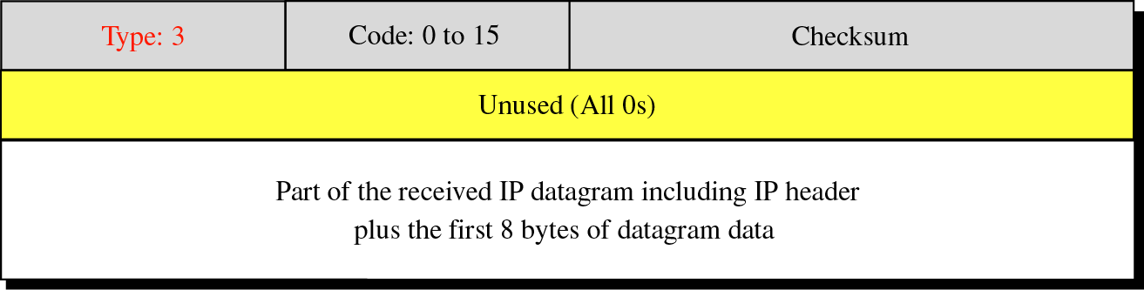
Figure 9-7
DESTINATION-UNREACHABLE FORMAT
Code 0 – Network is unreachable
Code 1 – Host is unreachable
Code 2 – Protocol is unreachable
Code 3 – Port is unreachable

Slide 10
  When a router cannot route a datagram or a host cannot deliver a datagram, the datagram is discarded and the router or the host sends a destination-unreachable message back to the source host that initiated the datagram.
Note that destination-unreachable messages can be created by either a router or the destination host
Destination-unreachable messages with codes 2 or 3 can be created only by the destination host. Other destination-unreachable messages can be created only by routers.
A router cannot detect all problems that prevent the delivery of a packet.

Slide 11
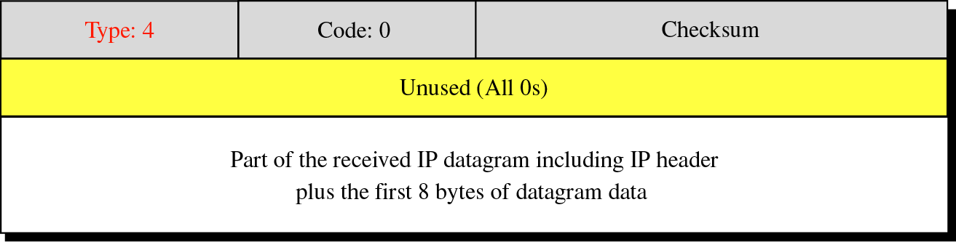
Figure 9-8
SOURCE-QUENCH FORMAT

Slide 12
A source-quench message informs the source that a datagram has been discarded due to congestion in a router or the destination host.
The source must slow down the sending of datagrams until the congestion is relieved.
One source-quench message should be sent for each datagram that is discarded due to congestion.

Slide 13
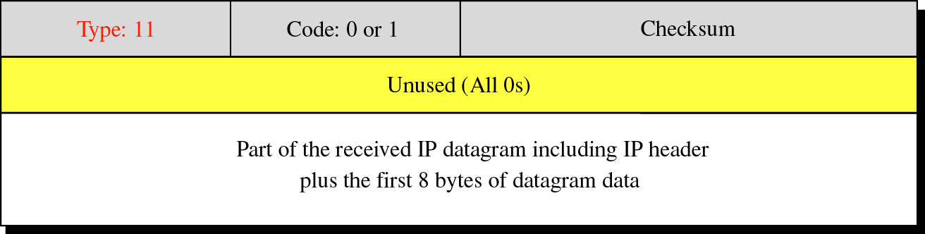
Figure 9-9
TIME-EXCEEDED MESSAGE FORMAT
Code 0: Time to live
Code 1: Fragmentation

Slide 14
Whenever a router receives a datagram with a time-to-live value of zero,it discards the datagram and
sends a time-exceeded message to the original source.
When the final destination does not receive all of the fragments in a set time, it discards the received
fragments and sends a time-exceeded message to the original source.
In a time-exceeded message,code 0 is used only by routers to show that the value of the time-to-live field is zero. Code 1 is used only by the destination
host to show that not all of the fragments have arrived within a set time

Slide 15
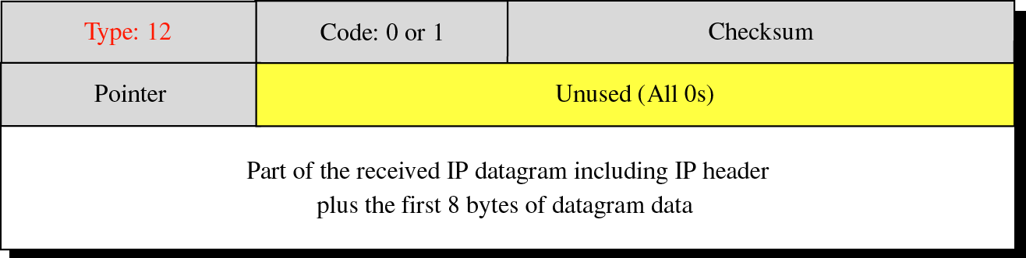
Figure 9-10
PARAMETER-PROBLEM MESSAGE FORMAT
Code 0: Main header problem
Code 1: Problem in the option field

Slide 16
If a router or destination discovers any ambiguity in any field of the datagram, it discards the datagram and sends a parameter-problem message back to the source.
A parameter-problem message can be created by a router or the destination host.

Slide 17
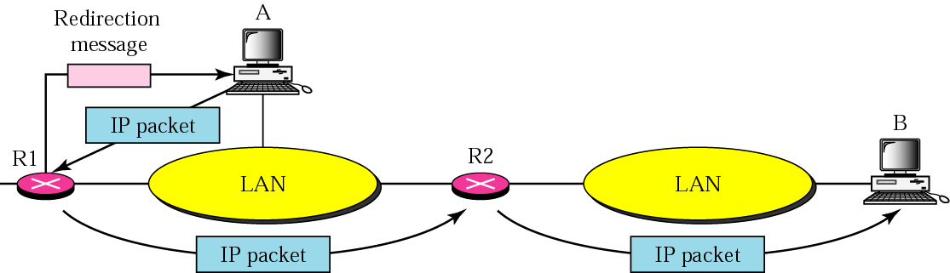
Figure 9-11
REDIRECTION CONCEPT
A host usually starts with a small routing table that is gradually augmented and updated. One of the tools to accomplish this is the redirection message.

Slide 18
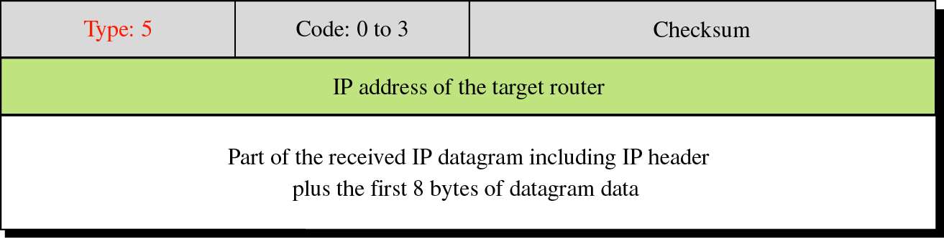
Figure 9-12
REDIRECTION MESSAGE FORMAT
Code 0: Network specific
Code 1: Host specific
Code 2: Network specific (specified service)
Code 3: Host specific (specified service)

Slide 19
QUERY

Slide 20
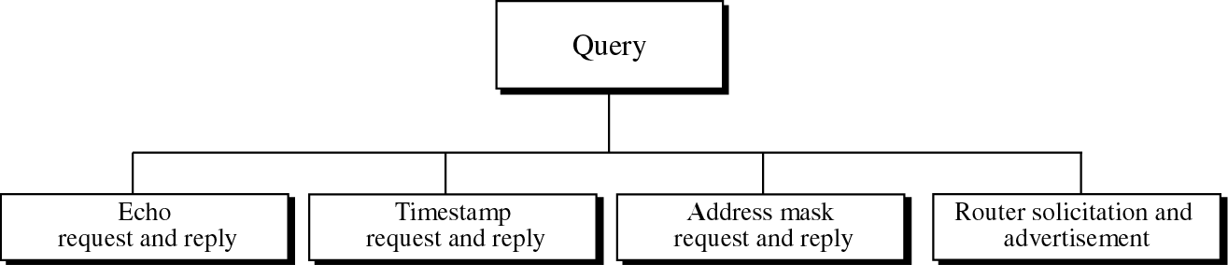
Figure 9-13
QUERY MESSAGES
The query messages, which occur in pairs, help a host or a network manager get specific information from a router or another host.
For example, nodes can discover their neighbors. Also, hosts can discover and learn about routers on their network, and routers can help a node redirect its messages.

Slide 21
ECHO REQUEST AND REPLY
The echo-request and echo-reply messages are designed for diagnostic purposes.
The combination of echo-request and echo-reply messages determines whether two systems (hosts or routers) can communicate with each other.
Echo-request and echo-reply messages can be used by network managers to check the operation of the IP protocol.
Echo-request and echo-reply messages can test the reachability of a host.This is usually done by invoking the ping command.

Slide 22
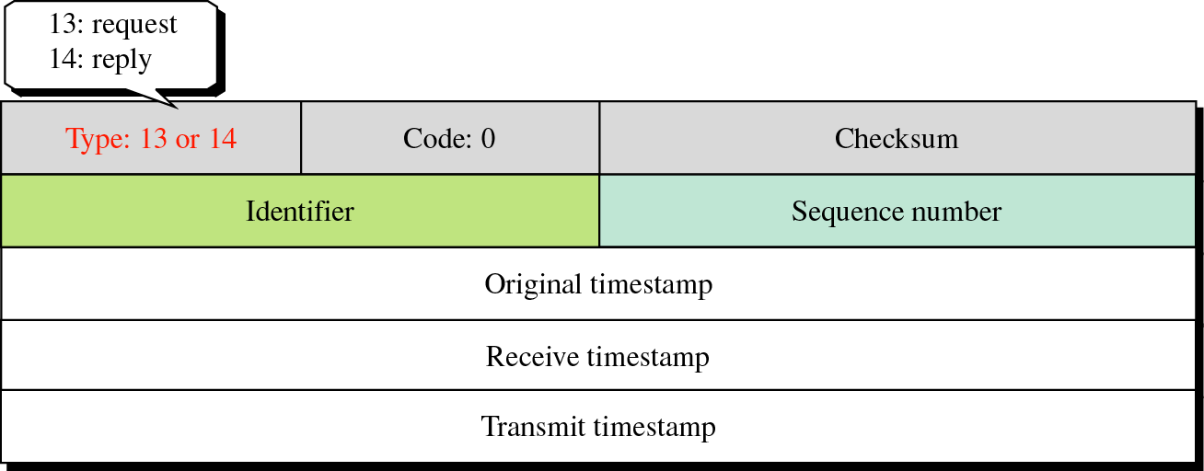
Figure 9-15
TIMESTAMP-REQUEST AND
TIMESTAMP-REPLY MESSAGE FORMAT

Slide 23
Two machines (hosts or routers) can use the timestamp request and timestamp reply messages to determine the round-trip time needed for an IP datagram to travel between them.
It can also be used to synchronize the clocks in two machines.
Sending time = value of receive timestamp −
value of original timestamp
Receiving time = time the packet returned −
value of transmit timestamp
Round-trip time = sending time +
receiving time

Slide 24
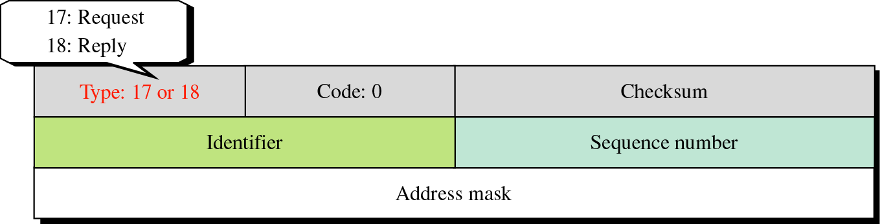
Figure 9-16
MASK-REQUEST AND MASK-REPLY MESSAGE FORMAT
To obtain its mask, a host sends an address-mask-request message
to a router on the LAN. If the host knows the address of the
router, it sends the request directly to the router.
If it does not know, it broadcasts the message. The router
receiving the address-mask-request message responds with an
address-mask-reply message, providing the necessary mask for
the host.

Slide 25
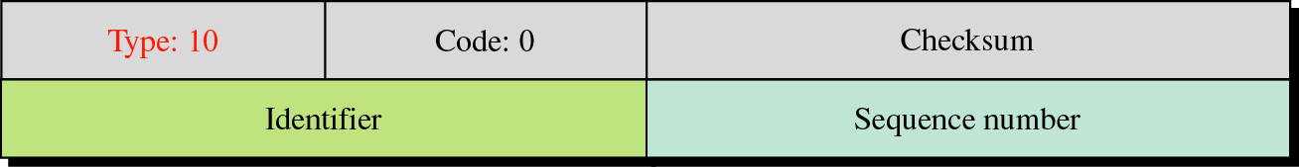
Figure 9-17
ROUTER SOLICITATION MESSAGE FORMAT
A host that wants to send data to a host on another network
needs to know the address of routers connected to its own
network.
Also, the host must know if the routers are alive and
functioning. The router-solicitation and router-advertisement
messages can help in this situation.
A host can broadcast (or multicast) a router-solicitation message.
The router or routers that receive the solicitation message
broadcast their routing information using the router-
advertisement message.

Slide 26
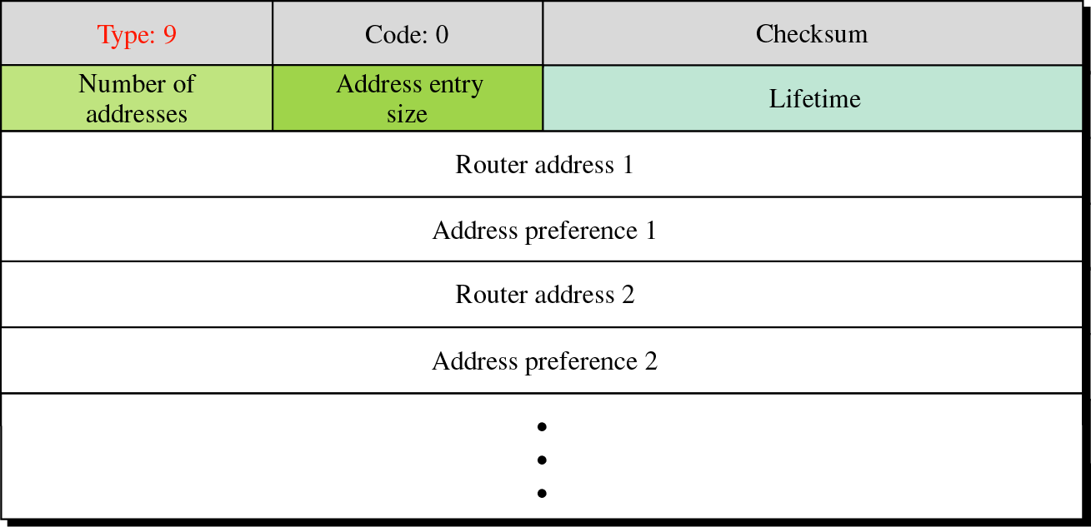
Figure 9-18
ROUTER ADVERTISEMENT MESSAGE FORMAT

